Slide 1
课前答疑
请准备好英语作业、课本和笔记本

Slide 2
Passage 1 1.My name is Michelle Rogers. For most of my life I had been fighting with my body weight. I was either gaining weight or trying to lose it. I wasn’t happy with myself, and I certainly wasn’t able to fully enjoy life. Not only did I feel bad physically, but I felt terrible emotionally. I also knew I wasn’t able to be the best I could be, and with failure after failure in losing weight, I just felt so hopeless to make it.
2.One day in 2008, I was looking through ads online and saw a treadmill (跑步机) for $100. This time I decided to start small and keep it doable. The first week I started walking 15 minutes on the treadmill at a fixed time every day. The next week I did 16 minutes. Each week I added a minute. Gradually, I increased speed as well as time. Once I got to 30 minutes, the weight started dropping off.
3.I didn’t lose weight at first, but I didn’t give up like I did in the past. I realized I started feeling better. My legs were getting stronger. I didn’t feel painful like I used to when I got up from my desk. All the efforts I’d been putting into fitness made me want to start eating healthier, too. I began with small changes as well. After these years I started listening to my body. It was refusing food and habits that were bad for me. 4.Today, the extra weight is gone. I still exercise every morning. I look and feel the best I have never done. Every area of my life has improved and benefited from this change in me. Not only do I have my youthful energy, looks and health back, but also I have more confidence than I have ever had.
【答案】1．B 2．A 3．D 4．C
1．How did Michelle feel about losing weight before 2008? A．Confident. B．Hopeless /desperate/disappointed. C．Addicted. D．Annoyed. 2．How many weeks had passed before Michelle’s weight began dropping? A．15 weeks. B．20 weeks. C．25 weeks. D．30 weeks. 3．What is NOT my practice now? A．Doing exercise regularly. B．Eating healthier. C．Refusing bad food and habits. D．Gaining extra weight.
4．What can we learn from Michelle’s story? A．Time is everything.B．Interest is the best teacher.C．Start with small things. D．Nothing is more important than confidence.

Slide 3
Passage 2
1.Sport is not only physically challenging, but can also be mentally challenging. Criticism (批评) from coaches, parents and other teammates, as well as pressure to win can create too much anxiety or stress for young athletes. Stress can be physical, emotional, or psychological and research has indicated that it can lead to burnout. Burnout has been described as dropping out of or quitting an activity that was at one time enjoyable.
2.The early years of growth are important years for learning about oneself and the sport setting is one where valuable experiences can take place. Young athletes can, for example, learn how to cooperate with others, make friends, and gain other social skills that will be used throughout their lives. Coaches and parents should be aware, at all times, that their feedback to youngsters can greatly affect their children. Youngsters may take their parents and coaches’ criticisms to heart and find faults in themselves.
3.Coaches and parents should also pay attention that youth sport participation does not become work for children. The outcome of the game should not be more important than the process of learning the sport and other life lessons. In today’s youth sport setting, young athletes may be worrying more about who will win instead of enjoying themselves and the sport. Following a game, many parents and coaches focus on the outcome and find faults with youngsters’ performances. Positive support should be provided regardless of the outcome. Research indicates that positive support encourages and has a greater effect on learning than criticism. Again, criticism can create high levels of stress, which can lead to burnout.
【答案】5．B 6．C 7．A 8．C
5．What is the main idea of the first paragraph?
A．Stress should be made less. B．Sport can be mentally challenging.
C．Mental stress should be reduced. D．Sport should be made less competitive.
6．Why is sport important for young people according to the passage?
A．It enables them to criticize themselves. B．It can help them learn more about society.
C．It can provide them with valuable experiences. D．It teaches them how to set realistic goals for themselves.
7．What should parents and coaches do according to the passage?
A．Make sure children enjoy sport. B．Help children to win every game.
C．Train children to deal with stress. D．Understand the meaning of sport.

Slide 4
Passage 2
1.Sport is not only physically challenging, but can also be mentally challenging. Criticism (批评) from coaches, parents and other teammates, as well as pressure to win can create too much anxiety or stress for young athletes. Stress can be physical, emotional, or psychological and research has indicated that it can lead to burnout. Burnout has been described as dropping out of or quitting an activity that was at one time enjoyable.
2.The early years of growth are important years for learning about oneself and the sport setting is one where valuable experiences can take place. Young athletes can, for example, learn how to cooperate with others, make friends, and gain other socia1 skills that will be used throughout their lives. Coaches and parents should be aware, at all times, that their feedback to youngsters can greatly affect their children. Youngsters may take their parents and coaches’ criticisms to heart and find faults in themselves.
3.Coaches and parents should also pay attention that youth sport participation does not become work for children. The outcome of the game should not be more important than the process of learning the sport and other life lessons. In today’s youth sport setting, young athletes may be worrying more about who will win instead of enjoying themselves and the sport. Following a game, many parents and coaches focus on the outcome and find faults with youngsters’ performances. Positive support should be provided regardless of the outcome. Research indicates that positive support encourages and has a greater effect on learning than criticism. Again, criticism can create high levels of stress, which can lead to burnout.
8．What’s the author’s purpose of writing the passage?
A．To teach young athletes how to avoid burnout.
B．To persuade young children not to worry about criticism.
C．To stress the importance of encouraging children in sport.
D．To discuss the skill of combing criticism with encouragement.
【答案】5．B 6．C 7．A 8．C

Slide 5
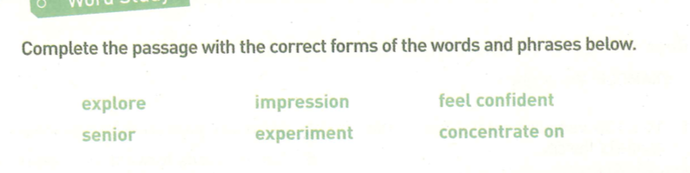
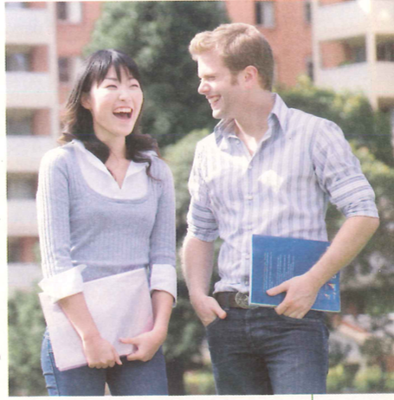
Word Study
Tian Hua is a new student at a school in America. She is studying at an American high school for one year. In China,Tian Hua was in Grade 1 at ________high school, but in America, she is in Grade 10! She did not_________________at all when she arrived. Her first__________was that English was difficult and people spoke too quickly, but soon she found that if she_________________the ideas not the single words, she could understand! She also made friends and began to__________the city with them. Her new friends were happy to explain things to her after class.Her favourite class is chemistry because the teacher lets the students do cool__________! Tian Hua is not sure how well she will do at school this year but she is not nervous any more. She is excited!
senior
feel confident
impression
concentrated on
explore
experiments

Slide 6









Language Points
In this lesson, you will be able to:
Learn some key words and phrases under the context of new school life.
Use the newly-learnt words and expressions to describe your first day of senior high school.

Slide 7
交换生
登记处
在学校
完成表格
在机场
以礼貌的方式
来自英国的师生访问团
在讲堂
在正式的场合
句子翻译：千里之行，始于足下。
an exchange student / exchange students
可数名词前冠词不要落
the registration office
on campus
该词组中没有冠词
complete the table
at the airport
in a polite way
a visiting group of teachers and students from England
in the lecture hall
in the formal situation / in formal situations
A thousand-mile journey begins with the first step.

Slide 8


Slide 9
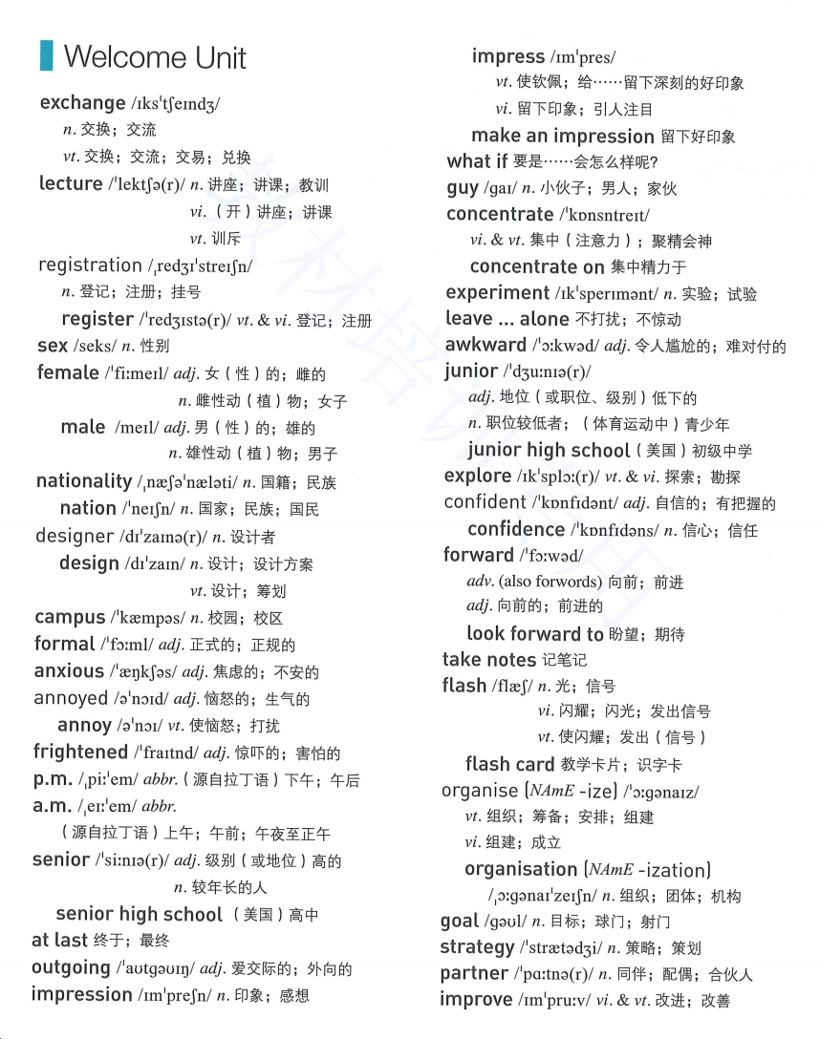

Slide 10

交换一个眼神？

Slide 13
It is the second time this year that our school Wushu team
_____________________________________________________!
这是我们学校武术队今年第二次与外国朋友交流经验！
It is/was+the+序数词+time that sb. has/had done sth. 某人第几次做某事
续写表达:
④ Juliet and David ___________________(相互看了看对方).
⑤I shook hands and _______________________ with the manager（……和经理相互交谈了几句）.
has exchanged experience with the foreign friends
for
for
exchanged glances
exchanged a few words

Slide 14
deliver/give a lecture
attend

Slide 15
翻译：他总是因为我的穿搭训斥我。
He always lectures me on/about my dressing way.

Slide 16
gender
national
international
注册公司/商标/学生
注册账号/号码
这辆车是以我的名字登记的。
registered
The car is registered in my name.

Slide 20


design n．设计；设计方案 vt．筹划
by design＝on purpose 有意地，故意地
designer n． 设计者
1).这项活动的目的是帮助下岗很长时间的人。
The programme is designed to help people who have been out of work for a long time．
2).据我所知，这门课是为初学者设计的。
As far as I know, the course is designed for beginners．
3). 旨在促进(promote)文化交流，民俗艺术展将于下周五在学校礼堂举行。（应用文活动类，design用法） _________________________________,the folk art exhibition is scheduled to be held in the_______________________ next Friday.
Designed to promote cultural exchanges
school lecture hall

Slide 21
on
in
n. anxiety

Slide 22
=

Slide 26
n. fright

Slide 28


a__________(frighten) look
frightened
a__________(frighten) look
frightening

Slide 29
senior a．高级的，年长的，资深的
幼儿园
小学
初中
高中
大学
nursery school/ kindergarten
primary school
junior high school
senior high school
university/ college

Slide 30



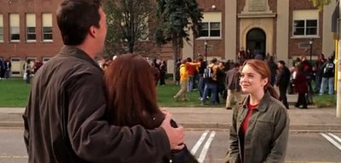


be senior/junior to
senior a．高级的，年长的，资深的
n．长辈，上司，（初高中）毕业班学生
senior
他在一家大公司担任高级职务。
He held a _________ position in a large company.
这个年轻的学生向学长咨询英语学习。
The young student consulted his senior about English study.

Slide 34
What kind of impression did your classmates leave on you the first day of senior high school?
多种表达：
1.I was impressed by XXX the first day because…
2.XXX impressed me a lot because…
3.XXX left a deep impression on me for..
4…. was very impressive…
5.What impressed me most was/were...

Slide 35
课前准备
请准备好英语听写本、作业本、课本和笔记本

Slide 36
默写 10点35分请在评论区一一作答
单词：
1.n./v. 交流，交换 2.register 写名词 3.n.校园
4.anxious 写名词 5.n.印象 再写出动词和形容词
6.adj.恼怒的，生气的 7.n.设计
词组
8.做演讲 9.老人 10.一个令人害怕的眼神
句子：
1.他的讲座让我印象深刻。（两种表达）

Slide 37
课前听写 10点33分请在评论区一一作答
单词：
1.exchange 2.registration 3.campus
4.anxiety 5. impression impress impressive
6.annoyed annoying 7.design
词组8.deliver a lecture 9.senior citizens 10.a frightening look/glance
句子：1.他的讲座让我印象深刻。（两种表达）
His lecture left a deep impression on me./I was impressed by
his lecture./What impressed me most was his lecture./
His lecture impressed me a lot./His lecture was impressive.

Slide 38
Welcome Unit： Language Points 课后练习答案 一、词汇练习 1. The television programme is designed to(为……而设计) educate children to share things with their friends. 2.If you concentrate on (专注于) what you don’t have, you will never, ever have enough. 3. Be confident in (对……有信心) yourself, and you will make your dream come true. 4. In order to make a good impression (留下好印象)during a job interview, you need to prepare yourself for the interview. 5.I feel annoyed right now, so you might as well leave me alone (不打扰). 6. Travelling is a good way to explore different cultures and broaden the mind. 旅行是探索不同文化和开阔眼界的好方法。

Slide 39
1.Along the hallway(走廊), I saw mixed expressions on the faces of my students: excited, nervous, and worried.No doubt about it: they were this term’s freshmen. My own first day at high school flashed into my mind.
2.Since our family had just moved to the place, I didn’t know anyone at the school. On arriving, I picked up a map and my schedule (日程表). Oh, my goodness, what a large school it was! Nervously, I looked about for where my first class was to be held.
3.When I finally found my class, everyone was talking and laughing together, and I felt so lonely. Throughout the day, each period brought some new faces I had not seen before. But when my English class came around, I had a surprise: an old classmate! It was Ben, who had left my middle school right after sixth grade. We talked and joked about middle school and the clubs we were in together. My nerves eased(放松) a little.
Next was the PE class. This was the first class that I found without difficulty. Sitting through the boring introduction to the class by the teacher, I started talking to a girl sitting near me. I found out that her family had just moved here too, and she didn’t know anyone either. As we talked, we discovered that we had a lot in common, and had a lot of classes together. This girl ended up becoming my best friend. I am so glad that I met her.
4.By the end of that day, I was full of optimism(乐观). I knew that high school would be an amazing experience.
1.The writer of this passage is a . A.parent B.college student C.high school student D.high school teacher
2.Why did the writer feel nervous while looking for her first class?
A.Because the school was very large. B.Because the map did not show the way.
C.Because the teacher would be serious. D.Because the first class would be difficult.
3.When did the writer feel less nervous?
A.After she met her old classmate Ben. B.After she made friends with a girl.
C.After she had PE class together with Ben. D.After she finally found her first class.
4.How did the writer feel about high school by the end of the day?
A.Nervous. B.Bored. C.Hopeful. D.Satisfied.
【答案】1．D 2．A 3．A 4．C

Slide 40
1.In America, when the eighth graders leave the middle school, they are often worried about moving to the high school. It is a hard time for them, but it can be an exciting one as well. To make it easier, students need to get familiar with their school.
2.Even though they’ve done this already in the middle school, it’s still important to find where their classrooms are. Most schools take students to the high school for a visit at the end of their eighth grade year. And, most schools also have a freshman(新生) speech for parents and students before the first year begins. Sometimes the main office will give away a map of the school. This can help students and parents to find different places in the school.
3.One way to know your high school more and make new friends is to join a club or play a sport. Schools often offer chances to join different clubs and sports. Fall activities begin in August before the first day of school. If you are not interested in sports, there are clubs for any interest, such as drama, dance, chess, photography, community service, etc. These clubs allow students from different grades. By joining an activity, students can find new friends, not to mention improving their chances in future college applications(申请). The school office will have a list of activities offered at the school and information on how to join them.
4.What’s more, to have a great start to a high school year, students can write down some of their worries, and ask for help from teachers and school workers.
【答案】5．B 6．D 7．C 8．D
5.According to the text, most students feel when entering the high school.
A.excited B.nervous C.lonely D.disappointed
6.Which of the following is TRUE about the school clubs?
A.There are fewer students from higher grades in the school clubs.
B.The school clubs in high school only welcome sports fans.
C.Summer activities begin before school starts.
D.The school office can help new students join school clubs.

Slide 41
1.In America, when the eighth graders leave the middle school, they are often worried about moving to the high school. It is a hard time for them, but it can be an exciting one as well. To make it easier, students need to get familiar with their school.
2.Even though they’ve done this already in the middle school, it’s still important to find where their classrooms are. Most schools take students to the high school for a visit at the end of their eighth grade year. And, most schools also have a freshman(新生) speech for parents and students before the first year begins. Sometimes the main office will give away a map of the school. This can help students and parents to find different places in the school.
3.One way to know your high school more and make new friends is to join a club or play a sport. Schools often offer chances to join different clubs and sports. Fall activities begin in August before the first day of school. If you are not interested in sports, there are clubs for any interest, such as drama, dance, chess, photography, community service, etc. These clubs allow students from different grades. By joining an activity, students can find new friends, not to mention improving their chances in future college applications(申请). The school office will have a list of activities offered at the school and information on how to join them.
4.What’s more, to have a great start to a high school year, students can write down some of their worries, and ask for help from teachers and school workers.
【答案】5．B 6．D 7．C 8．D
7.When do many schools take students to visit their new high school?
A.Before the eighth grade year starts. B.Right after the high school year starts.
C.At the end of their eighth grade year. D.At the beginning of the new term in the high school.
8.What is the purpose of this text?
A.To tell the new students how to learn in high school. B.To introduce new schools.
C.To give the teachers some advice. D.To give advice to new high school students.

Slide 44
翻译：如果设计师发现你把她的书弄丢了会怎么样？
What if the designer finds out that you have lost her book?

Slide 49
with + n. = adv.
with worry
with excitement
with hunger
worriedly
excitedly
hungrily
=confidently

Slide 50
confident -- confidence
adj.
n.
-ent | -ence
silent
different
talent
patient
violent

Slide 56

应用文积累：
我期待尽快收到你的回信。
I am looking forward to （receiving）your reply.
Looking forward to（receiving）your reply.
续写积累：
你一定是某个人翘首以盼的惊喜。

Slide 58
find + sb./sth. + doing
When she came into the room, she found them sitting together singing.
find + sb./sth. + done
When he arrived, he found all the work finished.
find + sb./sth. + adv.
I called on her on my way home and found her out.
find + sb./sth. + 介词短语
Jane found herself in a different world.

Slide 60
翻译：如果你坚持练习，你就会发现剪纸其实很简单。
If you keep practicing paper-cutting, you will find it easy.
listening
We turned around and found the exchange student __________(listen) to a lecture on Chinese culture.
She found herself __________(trap) into registering for a chargeable APP.
A cook will be immediately fired if he is found _________(smoke) in the kitchen.
trapped
smoking

Slide 61

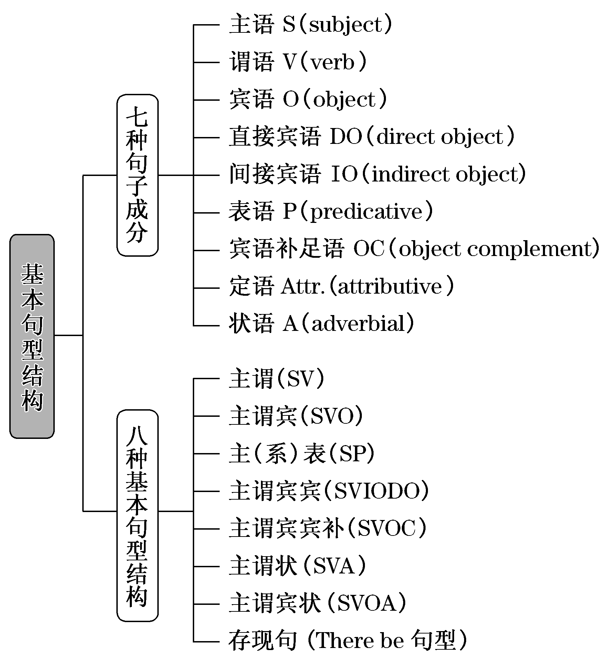

Slide 62
常见的句子成分：
S （subject）主语
V （verb）谓语
O （object）宾语
DO （direct object）直接宾语；IO（indirect object）间接宾语
P （predicative）表语
A （adverbial） 状语
C （object complement）宾语补足语

Slide 65
系动词：1. be (am is are was were) / seem / keep /…是/好象(似乎)是/保持
2. look / feel / taste / smell / sound / …看/感觉/尝/闻/听起来(上去)
3. become / turn / get / grow / …变得

Slide 75
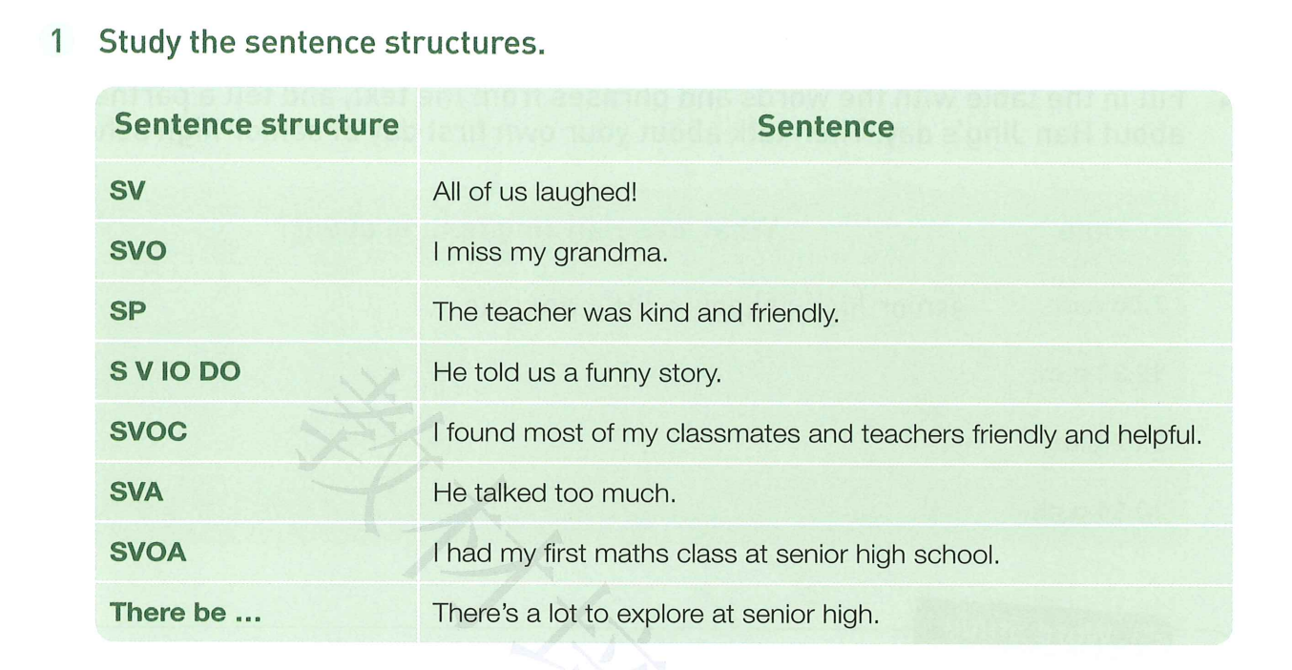

Slide 83
Homework
1.Finish exercise 2 &3 on p6 of the textbook.
2.Write down your learning life at home for about 50 words with at least 5 sentence structures.(活页纸，返校上交)
3.课后练习

Slide 84
Word Formation I
→ _________
sen年老+ior表示人
→ ________
impress给人印象+ion名词后缀
→ _______
con全部+fid相信、信念+ent…的
→______
de使…成为，加强+sign写，做标志

Slide 85
Word Formation II
①impression n.→________________(给人印象 v.)
→________________(给人印象深刻的 adj.)
②explore v.→_______________(探测；探究 n.)
→_______________(探险家 n.)
③exchange v./n.→______________(交换的 adj.)
④confident adj.→______________(自信 n.)
⑤design v./n.→_______________(设计师 n.)
→______________(精心设计的；有计划的 adj.)
impress
impressive
exploration
explorer
exchanged
confidence
designer
designed

Slide 86
Homework:
1.熟记语言点，准备听写 2.完成练习

Slide 87
交换生
登记处
在学校
完成表格
在机场
以礼貌的方式
来自英国的师生访问团
在讲堂
在正式的场合
句子翻译：千里之行，始于足下。
an exchange student / exchange students
可数名词前冠词不要落
the registration office
on campus
该词组中没有冠词
complete the table
at the airport
in a polite way
a visiting group of teachers and students from England
in the lecture hall
in the formal situation / in formal situations
A thousand-mile journey begins with the first step.

